Slide 1
Welcome!
DESIGNED BY MICHAEL PANAIT FOR HACK CLUB ARCADE
REPLACE (school’s) Hack Club with your Hack Club’s Name!
Feel free to modify anything in this presentation file.
(Your School) Hack Club - Interest Meeting

Slide 2
So… What exactly is Hack Club? Do I hack banks?
For the second question, No!
Hack Club is a global non-profit organisation that connects students interested in engineering and computer science together while also showcasing people the power of collaborative programming and free, open-source technology. Members have the opportunity to learn new skills and receive their ideas (or the tools to make that idea) in real life. Additionally, students can participate in global events, in-person or online. For example, Arcade was an event over the 2024 summer where students made awesome projects and won over $100,000 in prizes from Microsoft, Apple, Logitech, Prusa Research, Flipper (Zero), Framework, and more!

Slide 3
Why should I join? Why not (other CS clubs)?
No deadlines, No stress
(Your school’s) Hack Club is as flexible as you are. It can be your main or side club. There’s no deadlines, no homework, no stress, just learning and building.
Work with your hands, not concepts:
You can’t learn carpentry without wood. Follow live lessons and develop skills that help you create and not just consume in a technical world.
Get free stuff (that you can keep!):
From Drawing Robots, PCBs, Gaming Consoles, 3D Printers, Boba, or a Frappuccino! Learn skills, build cool stuff and get rewarded!

Slide 4
Meet your (school name) Hack Club Leaders!
Insert picture here!
Insert picture here!
First Last
Position
First Last
Position

Slide 5

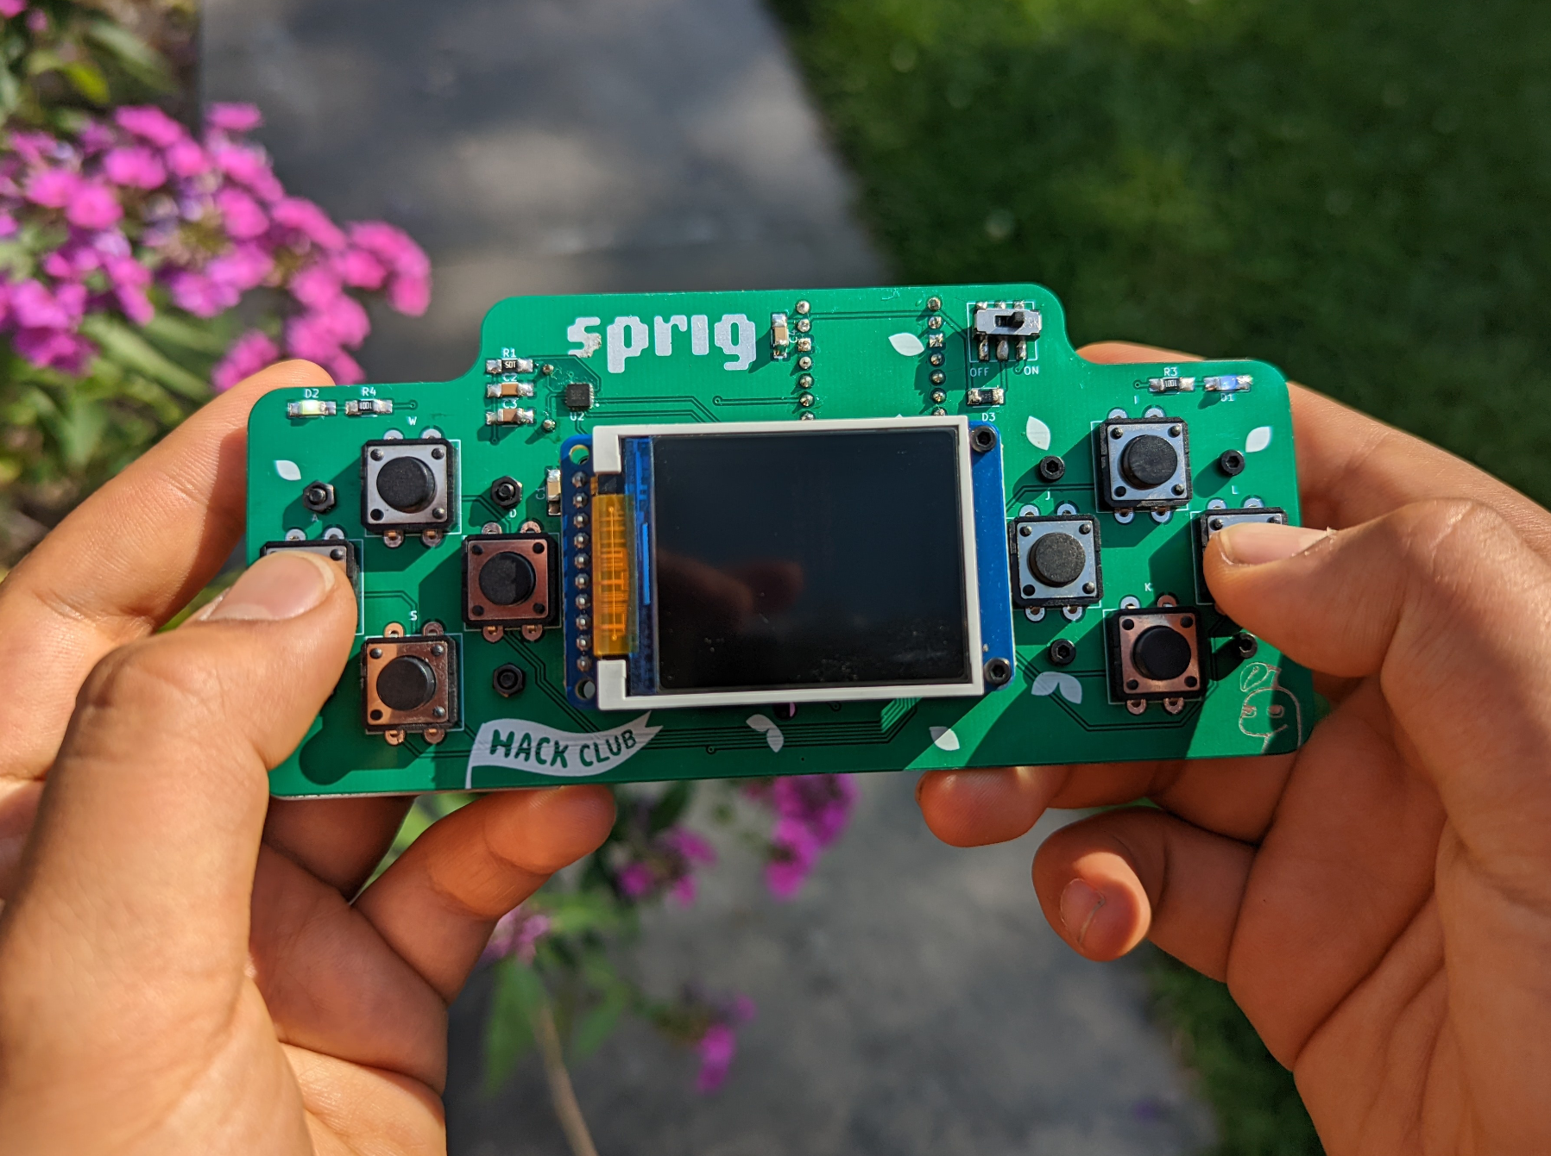
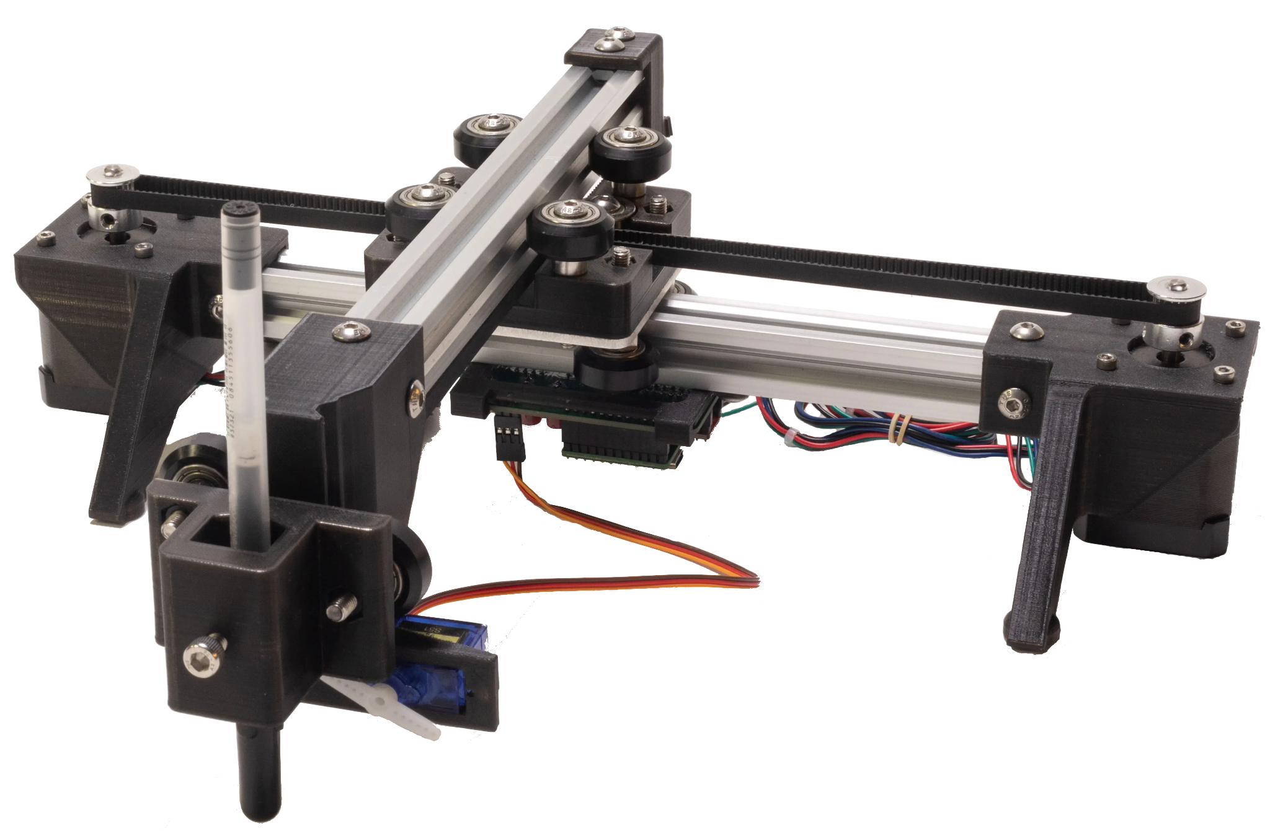
What can I get (for free)?
PCBs (OnBoard)
Handheld (Sprig)
Drawing Robot (Blot)
Get $100 to design a circuit board and get it produced and shipped to you!
Build a game, get a Raspberry Pi-powered gaming handheld to play it on!
Learn generative art, get a hackable drawing robot and see your art on paper!

Slide 6
What will we do in (school’s) Hack Club?
[This is my planned framework, feel free to use mine or make your own!]
(School’s) Hack Club is split into 2 semesters:
Fall Workshops:
You’ll work on Hack Club Jams/YSWS (You Ship, We Ship!) programs through the first semester. These teach important skills These include learning PCB design with Onboard, learning JerryScript (based on JS) and game development with Sprig, or building a personal site using CSS/HTML with Boba Drops.

Slide 7
What will we do in (school’s) Hack Club?
The Spring Ship!
A “ship” is a Hack Club term referring to publishing a project for the public to see! During the Spring, take on a larger Hack Club program like Blot, Forge, or an (advanced) OnBoard project or work on a self-made project, either by yourself or with a team that will get your idea off the ground!
In May, you’ll have the opportunity to demonstrate your finished project(s) to the rest of (school’s) Hack Club!

Slide 8
What if I need help?
Need help with something? Ask your peers or ask the tens of thousands of people on the Hack Club Slack, a global network of Hack Clubbers, ready to help answer any issue you come across in your project!
You’re not joining a club, you’re joining a community

Slide 9
What will we do in (school’s) Hack Club?
Hackathons
Feeling social? Check out Hackathons around (school’s) Hack Club like (local hackathon) and (hopefully another local hackathon). These events are free and Hack Club will even pay for gas! Hackathons are social events that let you meet other Hack Clubbers around your area and build not only cool stuff but lifetime friendships!

Slide 10
Just a heads up!
Student verification:
Hack Club’s resources are designed for teens only. Adults will and do attempt to abuse Hack Club programs which damages the integrity of these wonderful programs. Hack Club will ask for a considerable amount of personally-identifiable information (Full Legal name, Student ID/State ID, Home Address, Contact Info, ect) in order to verify your age. Hack Club is a legitimate, trusted program. Only 1 person at Hack Club sees your info and it stays like that. Use your name and age provided on official documentation. Additionally, do not mask your ID photos. This process should only occur once. You may have to re-verify if you’re receiving an expensive prize or benefit. (School’s) Hack Club requires verification. If this makes you uncomfortable, you’re welcome to leave and not return to (school’s) Hack Club. If you’d like to rejoin, please contact a leader and we’ll let you know when the next workshop is!

Slide 11
Any Questions?

Slide 12

How do I start?
Scan this QR code and download Slack on your phone.
Enter your email. Before the next meeting, make sure
you’re verified as a student and join the
#(club channel) channel on the Hack Club Slack.

Slide 13
Thanks for coming!
See you at the next meeting on ________ (08/XX/2X)

